Slide 1
BACK TO SCHOOL
2021 Program Report

Slide 2
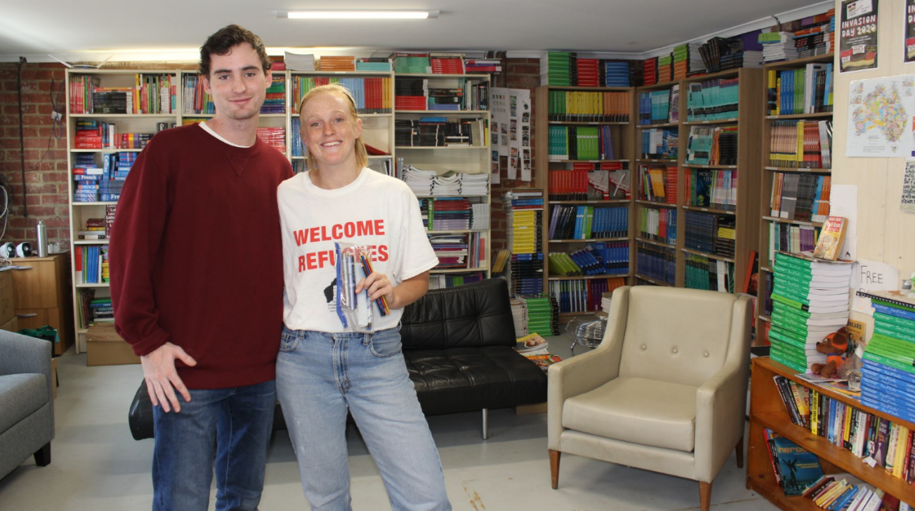
BACKGROUND
Getting kids back to school
Key statistics
Since 1989, our Back to School program has provided education resources, text books and stationery to students and families experiencing financial difficulty.
The aim of the program is to remove financial barriers to attending school.
The program operates on an annual basis with referrals commencing from late November and running until late January (or until funds are exhausted).
A young person must meet specific criteria to be eligible for the program and they are referred by their support worker or school.
500 young people supported
Over 30% of students were Indigenous or Torres Strait Islander
Students came from a wide range of cultural backgrounds – over 55 nationalities
Total spent on textbooks: $43k
Total saved on textbooks: $72k
Roughly $90 spent on textbooks per student

Slide 3
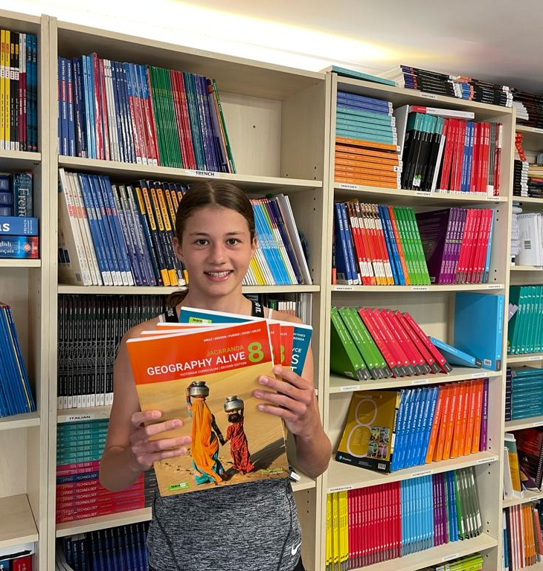
THE IMPACT OF COVID19
The COVID-19 pandemic saw a huge increase in demand:
Primary school referrals increased, with parents being asked to pay for materials and resourcing fees. These numbers were triple that of 2020.
We saw an increased demand for devices, which we’re unable to accommodate.
Students referred under the ‘special circumstances’ category soared by 28%, with many referrers indicating family violence, financial hardship and living with grandparents were reasons for support.

Slide 4
DEMOGRAPHICS
In 2021, 480 students received assistance with text books, stationery and digital tools.
This consisted of 53% females and 45% males.
All were secondary students bar 51 who were at primary school. This is triple the number of primary aged referrals from 2020
The ages ranged from as young as four to 19 years old.
The largest demand was from students in their first years of secondary school.

Slide 5
ELIGIBILITY CRITERIA
* ’Special Circumstances’ includes financial hardship, large households, children in out of home care, families experiencing domestic violence. Often young people involved in our internal programs are referred under ‘special circumstances’, however, the total internal referrals did not change for the 2021 year.

Slide 6
ELIGIBILITY CRITERIA - COMPARISON

Slide 7
CULTURAL BACKGROUND
Young people identified with a range of cultural backgrounds, 56 different backgrounds were listed on referral forms.
The top 5 backgrounds were:
Australian Aboriginal 31%
Australian 11%
Vietnamese 7%
Somali 5%
Congolese 4%

Slide 8
SCHOOLS AND LOCATIONS
Schools
Locations
We provided support to students in 134 different schools across Victoria.
The top 5 schools requiring the most support for students were:
Collingwood College
Reservoir High School
Braybrook College
Thornbury High School
Sunshine College
These are similar schools to 2020, however 2021 saw a significant increase in demand for students from Collingwood college (up by 34) and Reservoir High School (up by 24)
Students came to us from 128 suburbs across 33 Local Government Areas. The top 5 LGAs were:
Brimbank
Darebin
Whittlesea
Yarra
Casey

Slide 9
REFERRING AGENCIES
There were 55 external referring agencies (listed below) and 21 referring schools. Collingwood College referred the most young people outside of the Les Twentyman Foundation (26% of referrals in total).
Aboriginal Housing Victoria
AFRO
AMES Australia
Anglicare Victoria
Asylum Seeker Welcome Centre
Australian Red Cross
Brotherhood of St Laurence
Community Information and Support Moreland
Dandenong District Aboriginal Co-operative Limited*
Eastern Health Aboriginal Team
Foundation House
GMARs
Good Shepherd
Hobsons Bay Refugee Network Inc
Life Without Barriers
Livingstone Community Centre
MacKillop Family Services
Melbourne City Mission
Merri Health
Merri Outreach Support Service
Migrant Information Centre
Migrant Information Centre - Eastern Melbourne
New Zealand Support Network
Refugee Minor Program, DHHS
Salvation Army*
Spectrum MRC
The Bridge Youth Service
The Smith Family
Uniting Lentara & Kildonan Asylum Seeker Welcome Centre
VACCA
VACSAL*
VAHS
Windermere Child and Family Services
Women's Health West
*indicates the top 3 external referring agencies

Slide 10
CASE STUDY: A NEWLY ARRIVED FAMILY
On Friday afternoon a family came into our office seeking support for their son going into his first year of high school in Australia. We asked the father if they were excited, and he replied saying “my son is very excited but also nervous... we only arrived in Australia very recently so this is his first time going to school”.
Our Back to School coordinator, Sally, glanced down at the booklist and noticed that only one or two books on his list were ticked and asked if they needed anything else. The father - via his friend who was interpreting - advised they did not have everything, however they did not know if they could ask for more. The friend explained that the family were Kurdish and seeking asylum from the war in Syria, and that they would be happy to receive any support that our organisation could offer.
“This is exactly why we are here;
to assist you and your family with
these things”, and together we were
able to find all the items on the boy’s
booklist, including his scientific
calculator!

Slide 11
SUPPORTERS
Schools / Organisations
Volunteers
15 companies supported through providing free or discounted goods such as calculators, textbooks and stationary
8 bookshops were engaged providing discounts, others bought our excess stock and provided store credit with a discount
28 schools donated nearly 560 boxes of texts including Trinity Grammar School, Xavier College, Scotch College, Wesley College and Camberwell Grammar School
25 volunteers (and some family members)
Massive thank you to Kate McCarthy for her negotiations with book shops and publishers, schools and exceptional organisational skills
Huge thanks to Alan and Galia Hardy, Yvonne Hartley and Jan Wright for their manual labour and tech skills
Financial Supporters
Disposal of books
The Miller Foundation
The Randall Foundation
Jenkins Family Foundation
Janet Kaye
Collier Charitable Fund
Tobin Brothers Foundation
Robert Spee
Country Women’s Association (Williamstown)
6 agencies were able to take surplus books:
Maman Anne Baba
Somaliland Community Australia
Coen Regional Aboriginal Corporation
The Italian Project
Japaneasy
Detention Education Australia

Slide 12
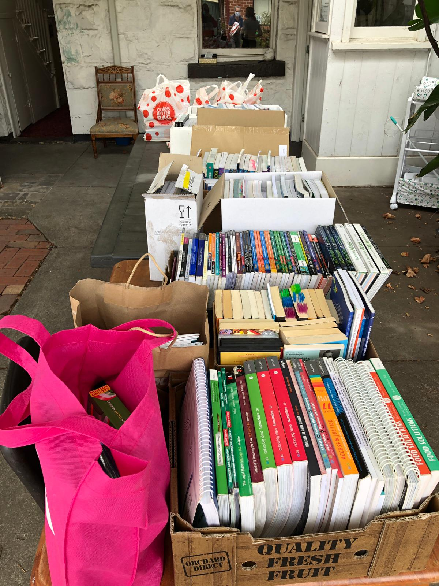
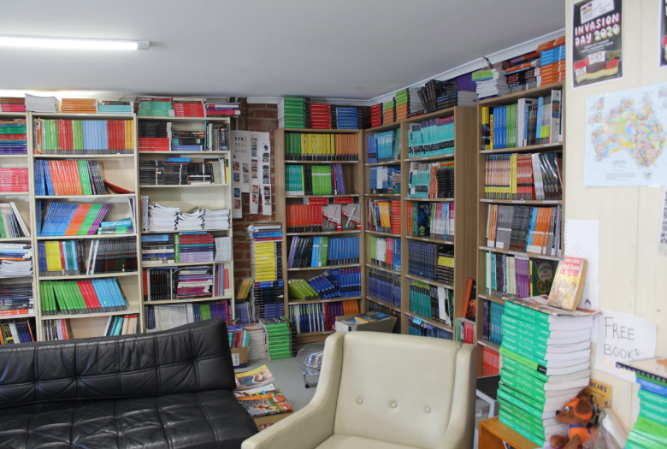
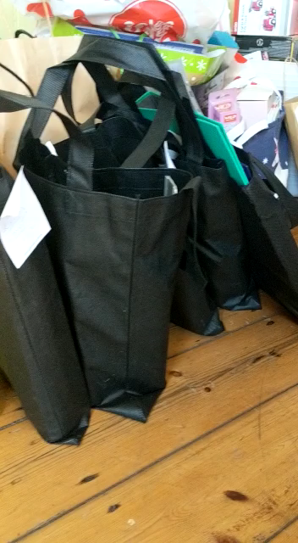
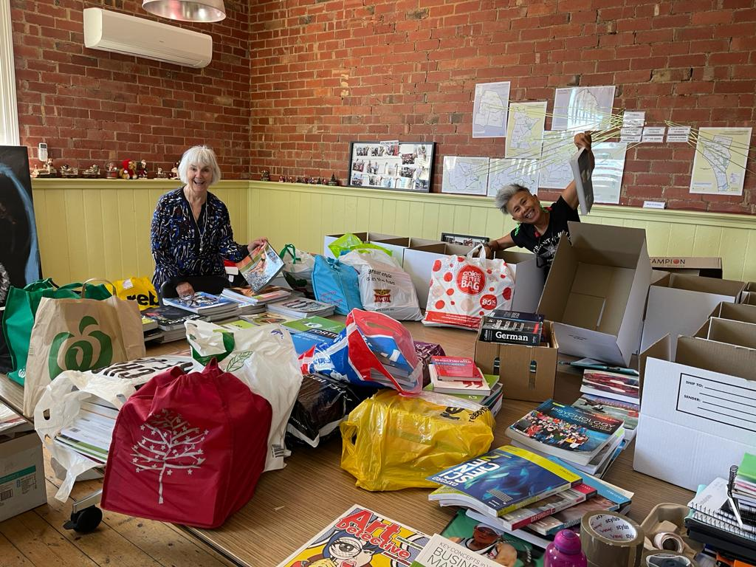

Slide 13

